Slide 1


Regulatory Scoping Exercise of IMO instruments
The 4th UK Maritime Autonomous Systems
Regulatory Conference
2019-01-17
Henrik Tunfors
Senior advisor

Slide 2
International Maritime Organization
1948 Inter-Governmental Maritime Consultative Organization (IMCO), changed to IMO in 1982
The IMO Convention entered into force in 1958
Governance and organization structure:
  Assembly
  Council
  Main Committees (MSC, MEPC, LEG, FAL)
  Sub-Committees
Member States and International Organizations (IGOs, NGOs etc.)

Slide 3
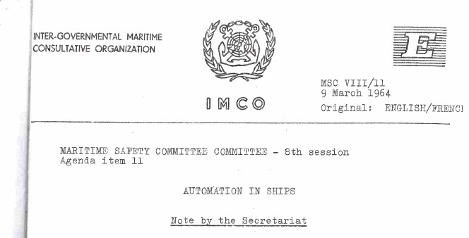
Looking back…
MSC VIII (March 1964)…

Slide 4
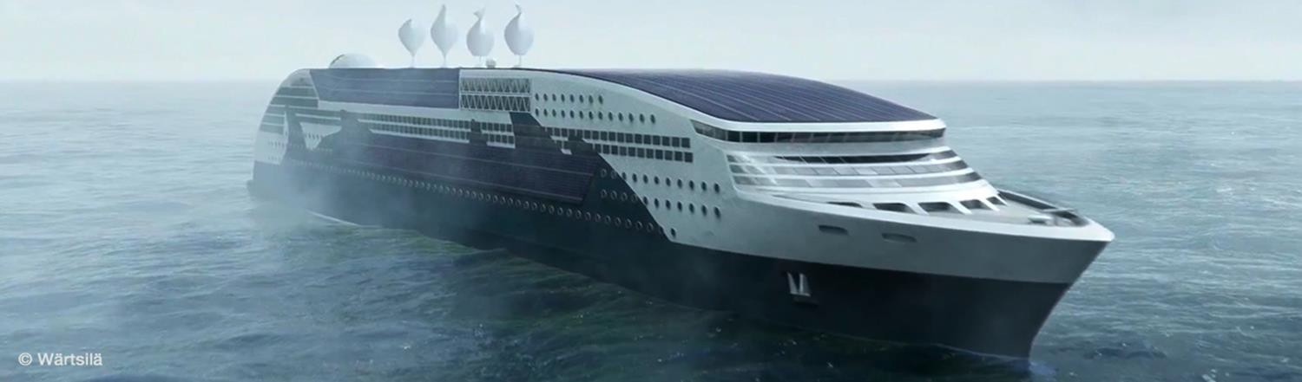
Autonomous ships
IMO’s regulatory scoping exercise on MASS
The ninety-eighth session of the Maritime Safety Committee (MSC 98), agreed to work on a "Regulatory scoping exercise for the use of Maritime Autonomous Surface Ships (MASS)", with a target completion year of 2020.

Slide 5
Autonomous ships
IMO’s regulatory scoping exercise on MASS
Why?
The Organization should be proactive and take a leading role on this
issue
To review IMO’s international regulatory framework and
Determine which provisions apply or not to MASS and may preclude or not MASS operations (as currently drafted)
Identify gaps or issues and analyse the best way to address.

Slide 6
Autonomous ships
IMO’s regulatory scoping exercise on MASS
MSC 98–100 (June 2017–December 2018)
The need to take into consideration the human element and legal aspects
Not a “drafting exercise”
The work on MASS should be user-driven and not technology driven
LEG 105 (April 2018) RSE with a target completion year of 2023 for LEG instruments.
MSC to take a coordinating role.

Slide 7
Autonomous ships
IMO’s regulatory scoping exercise on MASS
Framework – definition
For the purpose of the regulatory scoping exercise, MASS is defined as:
“a ship which, to a varying degree, can operate independent of human interaction”

Slide 8
Autonomous ships
IMO’s regulatory scoping exercise on MASS
Framework – degrees of autonomy
Ship with automated processes and decision support
Remotely controlled ship with seafarers on board
Remotely controlled ship without seafarers on board
Fully autonomous ship.

Slide 9
Autonomous ships
IMO’s regulatory scoping exercise on MASS
Framework – methodology – the 2 steps
First step: to identify provisions in IMO instruments which, as currently drafted:
First step “regulation by regulation”
Second step: to analyse and determine the most appropriate way of addressing MASS operations, taking into account, inter alia, human element, technology and operational factors by:
Second step “high level”.

Slide 10
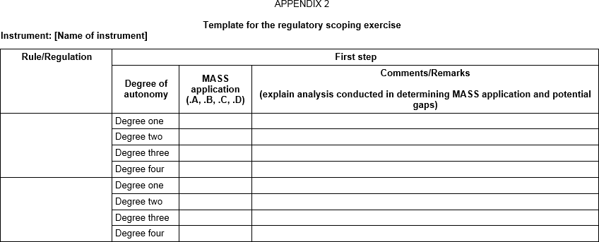
Autonomous ships
IMO’s regulatory scoping exercise on MASS
Framework – documentation step 1

Slide 11

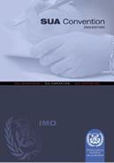
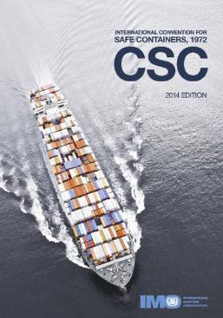
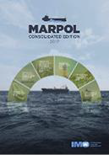
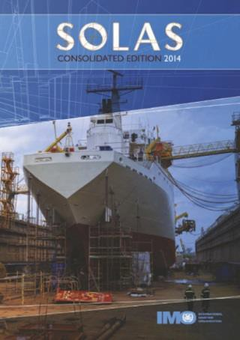
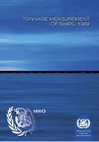
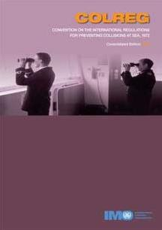
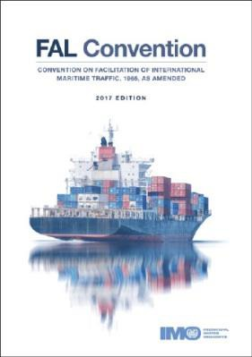
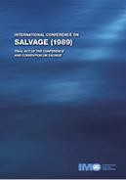
Instruments to be considered
COLREGs 1972
CSC 1972
LL 1966
LL PROT 1988
SAR 1979
SOLAS 1974
SOLAS AGR 1996
SOLAS PROT 1978
STCW 1978
STCW-F 1995
STP 1971
SPACE STP 1973
TONNAGE 1969
…and Codes.
MARPOL 73/78 FAL 1972
SUA 2005
SALVAGE 1989
OPRC 1990
CLC 1969
NUCLEAR 1971
HNS 1996
…

Slide 12
Autonomous/Smart ships
IMO’s regulatory scoping exercise on MASS
Timeline for the regulatory scoping exercise (MSC)
First step: January-April-September 2019
Inter-Sessional Working Group September 2019
Second step: October-December 2019
MSC 102 Final consideration: May 2020

Slide 13
Autonomous/Smart ships
IMO’s regulatory scoping exercise on MASS
List of instruments and volunteering States
Instrument | Chapter/ Section | Degree of autonomy | Member State preparing the initial review | Supporting/assisting
SOLAS 1974
 | Chapter II-1 | All | France | Sweden, Iran (Islamic Republic of)
 | Chapter II-2 | All | Japan
 | Chapter III | All | Netherlands | Belgium
 | Chapter IV | All | Turkey | China, Japan
 | Chapter V | All | China | Denmark, Japan, Singapore
 | Chapter VI | All | Japan
 | Chapter VII | All | Japan
 | Chapter IX | All | Norway | China, Republic of Korea, Russian Federation
 | Chapter XI-1 | All | Finland
 | Chapter XI-2 | All | Finland

Slide 14
Autonomous/Smart ships
IMO’s regulatory scoping exercise on MASS
List of instruments cont’d
Instrument | Chapter/ Section | Degree of autonomy | Member State preparing the initial review | Supporting/assisting
SOLAS AGR 1996
SOLAS PROT 1978
SOLAS PROT 1988
STCW 1978 and STCW Code |  | All | United States | Japan, New Zealand, Republic of Korea, Russian Federation,
STCW-F 1995 |  | All | Japan | New Zealand
COLREG 1972 |  | All | Marshall Islands | China, Japan, Singapore, United States
CSC 1972 |  | All | Japan | Finland
LL 1966 |  | All | India
LL PROT 1988 |  | All | India
SAR 1979 |  | All | Spain, France | Turkey
SPACE STP 1973
STP 1971
TONNAGE 1969

Slide 15
Summing up and final remarks
Regulatory scoping exercise on Maritime Autonomous Surface Ships (MASS)
High level exercise
Deadlines 2020/2023 so far
MSC, LEG --- MEPC, FAL?
Participation of all stakeholders is required: IMO, ship owners, industry, Administrations, shore services, other international organizations, amongst others
MSC 101 to consider proposals related to the development of guidance
for MASS trials.

Slide 16
Thank you for your attention!
Questions?

Slide 17


The Swedish Transport Agency
We enable the travel and
transport needs of tomorrow
@transportstyrelsen @TS_Nyheter

Slide 18
Regulatory Scoping Exercise of IMO instruments
The 4th UK Maritime Autonomous Systems
Regulatory Conference
2019-01-17
Henrik Tunfors
Senior advisor

Slide 19
International Maritime Organization
1948 Inter-Governmental Maritime Consultative Organization (IMCO), changed to IMO in 1982
The IMO Convention entered into force in 1958
Governance and organization structure:
  Assembly
  Council
  Main Committees (MSC, MEPC, LEG, FAL)
  Sub-Committees
Member States and International Organizations (IGOs, NGOs etc.)

Slide 20
Looking back…
MSC VIII (March 1964)…

Slide 21
Autonomous ships
IMO’s regulatory scoping exercise on MASS
The ninety-eighth session of the Maritime Safety Committee (MSC 98), agreed to work on a "Regulatory scoping exercise for the use of Maritime Autonomous Surface Ships (MASS)", with a target completion year of 2020.

Slide 22
Autonomous ships
IMO’s regulatory scoping exercise on MASS
Why?
The Organization should be proactive and take a leading role on this
issue
To review IMO’s international regulatory framework and
Determine which provisions apply or not to MASS and may preclude or not MASS operations (as currently drafted)
Identify gaps or issues and analyse the best way to address.

Slide 23
Autonomous ships
IMO’s regulatory scoping exercise on MASS
MSC 98–100 (June 2017–December 2018)
The need to take into consideration the human element and legal aspects
Not a “drafting exercise”
The work on MASS should be user-driven and not technology driven
LEG 105 (April 2018) RSE with a target completion year of 2023 for LEG instruments.
MSC to take a coordinating role.

Slide 24
Autonomous ships
IMO’s regulatory scoping exercise on MASS
Framework – definition
For the purpose of the regulatory scoping exercise, MASS is defined as:
“a ship which, to a varying degree, can operate independent of human interaction”

Slide 25
Autonomous ships
IMO’s regulatory scoping exercise on MASS
Framework – degrees of autonomy
Ship with automated processes and decision support
Remotely controlled ship with seafarers on board
Remotely controlled ship without seafarers on board
Fully autonomous ship.

Slide 26
Autonomous ships
IMO’s regulatory scoping exercise on MASS
Framework – methodology – the 2 steps
First step: to identify provisions in IMO instruments which, as currently drafted:
First step “regulation by regulation”
Second step: to analyse and determine the most appropriate way of addressing MASS operations, taking into account, inter alia, human element, technology and operational factors by:
Second step “high level”.

Slide 27
Autonomous ships
IMO’s regulatory scoping exercise on MASS
Framework – documentation step 1

Slide 28
Instruments to be considered
COLREGs 1972
CSC 1972
LL 1966
LL PROT 1988
SAR 1979
SOLAS 1974
SOLAS AGR 1996
SOLAS PROT 1978
STCW 1978
STCW-F 1995
STP 1971
SPACE STP 1973
TONNAGE 1969
…and Codes.
MARPOL 73/78 FAL 1972
SUA 2005
SALVAGE 1989
OPRC 1990
CLC 1969
NUCLEAR 1971
HNS 1996
…

Slide 29
Autonomous/Smart ships
IMO’s regulatory scoping exercise on MASS
Timeline for the regulatory scoping exercise (MSC)
First step: January-April-September 2019
Inter-Sessional Working Group September 2019
Second step: October-December 2019
MSC 102 Final consideration: May 2020

Slide 30
Autonomous/Smart ships
IMO’s regulatory scoping exercise on MASS
List of instruments and volunteering States
Instrument | Chapter/ Section | Degree of autonomy | Member State preparing the initial review | Supporting/assisting
SOLAS 1974
 | Chapter II-1 | All | France | Sweden, Iran (Islamic Republic of)
 | Chapter II-2 | All | Japan
 | Chapter III | All | Netherlands | Belgium
 | Chapter IV | All | Turkey | China, Japan
 | Chapter V | All | China | Denmark, Japan, Singapore
 | Chapter VI | All | Japan
 | Chapter VII | All | Japan
 | Chapter IX | All | Norway | China, Republic of Korea, Russian Federation
 | Chapter XI-1 | All | Finland
 | Chapter XI-2 | All | Finland

Slide 31
Autonomous/Smart ships
IMO’s regulatory scoping exercise on MASS
List of instruments cont’d
Instrument | Chapter/ Section | Degree of autonomy | Member State preparing the initial review | Supporting/assisting
SOLAS AGR 1996
SOLAS PROT 1978
SOLAS PROT 1988
STCW 1978 and STCW Code |  | All | United States | Japan, New Zealand, Republic of Korea, Russian Federation,
STCW-F 1995 |  | All | Japan | New Zealand
COLREG 1972 |  | All | Marshall Islands | China, Japan, Singapore, United States
CSC 1972 |  | All | Japan | Finland
LL 1966 |  | All | India
LL PROT 1988 |  | All | India
SAR 1979 |  | All | Spain, France | Turkey
SPACE STP 1973
STP 1971
TONNAGE 1969

Slide 32
Summing up and final remarks
Regulatory scoping exercise on Maritime Autonomous Surface Ships (MASS)
High level exercise
Deadlines 2020/2023 so far
MSC, LEG --- MEPC, FAL?
Participation of all stakeholders is required: IMO, ship owners, industry, Administrations, shore services, other international organizations, amongst others
MSC 101 to consider proposals related to the development of guidance
for MASS trials.

Slide 33
Thank you for your attention!
Questions?

Slide 34
The Swedish Transport Agency
We enable the travel and
transport needs of tomorrow
@transportstyrelsen @TS_Nyheter

Slide 35
Regulatory Scoping Exercise of IMO instruments
The 4th UK Maritime Autonomous Systems
Regulatory Conference
2019-01-17
Henrik Tunfors
Senior advisor

Slide 36
International Maritime Organization
1948 Inter-Governmental Maritime Consultative Organization (IMCO), changed to IMO in 1982
The IMO Convention entered into force in 1958
Governance and organization structure:
  Assembly
  Council
  Main Committees (MSC, MEPC, LEG, FAL)
  Sub-Committees
Member States and International Organizations (IGOs, NGOs etc.)

Slide 37
Looking back…
MSC VIII (March 1964)…

Slide 38
Autonomous ships
IMO’s regulatory scoping exercise on MASS
The ninety-eighth session of the Maritime Safety Committee (MSC 98), agreed to work on a "Regulatory scoping exercise for the use of Maritime Autonomous Surface Ships (MASS)", with a target completion year of 2020.

Slide 39
Autonomous ships
IMO’s regulatory scoping exercise on MASS
Why?
The Organization should be proactive and take a leading role on this
issue
To review IMO’s international regulatory framework and
Determine which provisions apply or not to MASS and may preclude or not MASS operations (as currently drafted)
Identify gaps or issues and analyse the best way to address.

Slide 40
Autonomous ships
IMO’s regulatory scoping exercise on MASS
MSC 98–100 (June 2017–December 2018)
The need to take into consideration the human element and legal aspects
Not a “drafting exercise”
The work on MASS should be user-driven and not technology driven
LEG 105 (April 2018) RSE with a target completion year of 2023 for LEG instruments.
MSC to take a coordinating role.

Slide 41
Autonomous ships
IMO’s regulatory scoping exercise on MASS
Framework – definition
For the purpose of the regulatory scoping exercise, MASS is defined as:
“a ship which, to a varying degree, can operate independent of human interaction”

Slide 42
Autonomous ships
IMO’s regulatory scoping exercise on MASS
Framework – degrees of autonomy
Ship with automated processes and decision support
Remotely controlled ship with seafarers on board
Remotely controlled ship without seafarers on board
Fully autonomous ship.

Slide 43
Autonomous ships
IMO’s regulatory scoping exercise on MASS
Framework – methodology – the 2 steps
First step: to identify provisions in IMO instruments which, as currently drafted:
First step “regulation by regulation”
Second step: to analyse and determine the most appropriate way of addressing MASS operations, taking into account, inter alia, human element, technology and operational factors by:
Second step “high level”.

Slide 44
Autonomous ships
IMO’s regulatory scoping exercise on MASS
Framework – documentation step 1

Slide 45
Instruments to be considered
COLREGs 1972
CSC 1972
LL 1966
LL PROT 1988
SAR 1979
SOLAS 1974
SOLAS AGR 1996
SOLAS PROT 1978
STCW 1978
STCW-F 1995
STP 1971
SPACE STP 1973
TONNAGE 1969
…and Codes.
MARPOL 73/78 FAL 1972
SUA 2005
SALVAGE 1989
OPRC 1990
CLC 1969
NUCLEAR 1971
HNS 1996
…

Slide 46
Autonomous/Smart ships
IMO’s regulatory scoping exercise on MASS
Timeline for the regulatory scoping exercise (MSC)
First step: January-April-September 2019
Inter-Sessional Working Group September 2019
Second step: October-December 2019
MSC 102 Final consideration: May 2020

Slide 47
Autonomous/Smart ships
IMO’s regulatory scoping exercise on MASS
List of instruments and volunteering States
Instrument | Chapter/ Section | Degree of autonomy | Member State preparing the initial review | Supporting/assisting
SOLAS 1974
 | Chapter II-1 | All | France | Sweden, Iran (Islamic Republic of)
 | Chapter II-2 | All | Japan
 | Chapter III | All | Netherlands | Belgium
 | Chapter IV | All | Turkey | China, Japan
 | Chapter V | All | China | Denmark, Japan, Singapore
 | Chapter VI | All | Japan
 | Chapter VII | All | Japan
 | Chapter IX | All | Norway | China, Republic of Korea, Russian Federation
 | Chapter XI-1 | All | Finland
 | Chapter XI-2 | All | Finland

Slide 48
Autonomous/Smart ships
IMO’s regulatory scoping exercise on MASS
List of instruments cont’d
Instrument | Chapter/ Section | Degree of autonomy | Member State preparing the initial review | Supporting/assisting
SOLAS AGR 1996
SOLAS PROT 1978
SOLAS PROT 1988
STCW 1978 and STCW Code |  | All | United States | Japan, New Zealand, Republic of Korea, Russian Federation,
STCW-F 1995 |  | All | Japan | New Zealand
COLREG 1972 |  | All | Marshall Islands | China, Japan, Singapore, United States
CSC 1972 |  | All | Japan | Finland
LL 1966 |  | All | India
LL PROT 1988 |  | All | India
SAR 1979 |  | All | Spain, France | Turkey
SPACE STP 1973
STP 1971
TONNAGE 1969

Slide 49
Summing up and final remarks
Regulatory scoping exercise on Maritime Autonomous Surface Ships (MASS)
High level exercise
Deadlines 2020/2023 so far
MSC, LEG --- MEPC, FAL?
Participation of all stakeholders is required: IMO, ship owners, industry, Administrations, shore services, other international organizations, amongst others
MSC 101 to consider proposals related to the development of guidance
for MASS trials.

Slide 50
Thank you for your attention!
Questions?

Slide 51
The Swedish Transport Agency
We enable the travel and
transport needs of tomorrow
@transportstyrelsen @TS_Nyheter

Slide 52
Regulatory Scoping Exercise of IMO instruments
The 4th UK Maritime Autonomous Systems
Regulatory Conference
2019-01-17
Henrik Tunfors
Senior advisor

Slide 53
International Maritime Organization
1948 Inter-Governmental Maritime Consultative Organization (IMCO), changed to IMO in 1982
The IMO Convention entered into force in 1958
Governance and organization structure:
  Assembly
  Council
  Main Committees (MSC, MEPC, LEG, FAL)
  Sub-Committees
Member States and International Organizations (IGOs, NGOs etc.)

Slide 54
Looking back…
MSC VIII (March 1964)…

Slide 55
Autonomous ships
IMO’s regulatory scoping exercise on MASS
The ninety-eighth session of the Maritime Safety Committee (MSC 98), agreed to work on a "Regulatory scoping exercise for the use of Maritime Autonomous Surface Ships (MASS)", with a target completion year of 2020.

Slide 56
Autonomous ships
IMO’s regulatory scoping exercise on MASS
Why?
The Organization should be proactive and take a leading role on this
issue
To review IMO’s international regulatory framework and
Determine which provisions apply or not to MASS and may preclude or not MASS operations (as currently drafted)
Identify gaps or issues and analyse the best way to address.

Slide 57
Autonomous ships
IMO’s regulatory scoping exercise on MASS
MSC 98–100 (June 2017–December 2018)
The need to take into consideration the human element and legal aspects
Not a “drafting exercise”
The work on MASS should be user-driven and not technology driven
LEG 105 (April 2018) RSE with a target completion year of 2023 for LEG instruments.
MSC to take a coordinating role.

Slide 58
Autonomous ships
IMO’s regulatory scoping exercise on MASS
Framework – definition
For the purpose of the regulatory scoping exercise, MASS is defined as:
“a ship which, to a varying degree, can operate independent of human interaction”

Slide 59
Autonomous ships
IMO’s regulatory scoping exercise on MASS
Framework – degrees of autonomy
Ship with automated processes and decision support
Remotely controlled ship with seafarers on board
Remotely controlled ship without seafarers on board
Fully autonomous ship.

Slide 60
Autonomous ships
IMO’s regulatory scoping exercise on MASS
Framework – methodology – the 2 steps
First step: to identify provisions in IMO instruments which, as currently drafted:
First step “regulation by regulation”
Second step: to analyse and determine the most appropriate way of addressing MASS operations, taking into account, inter alia, human element, technology and operational factors by:
Second step “high level”.

Slide 61
Autonomous ships
IMO’s regulatory scoping exercise on MASS
Framework – documentation step 1

Slide 62
Instruments to be considered
COLREGs 1972
CSC 1972
LL 1966
LL PROT 1988
SAR 1979
SOLAS 1974
SOLAS AGR 1996
SOLAS PROT 1978
STCW 1978
STCW-F 1995
STP 1971
SPACE STP 1973
TONNAGE 1969
…and Codes.
MARPOL 73/78 FAL 1972
SUA 2005
SALVAGE 1989
OPRC 1990
CLC 1969
NUCLEAR 1971
HNS 1996
…

Slide 63
Autonomous/Smart ships
IMO’s regulatory scoping exercise on MASS
Timeline for the regulatory scoping exercise (MSC)
First step: January-April-September 2019
Inter-Sessional Working Group September 2019
Second step: October-December 2019
MSC 102 Final consideration: May 2020

Slide 64
Autonomous/Smart ships
IMO’s regulatory scoping exercise on MASS
List of instruments and volunteering States
Instrument | Chapter/ Section | Degree of autonomy | Member State preparing the initial review | Supporting/assisting
SOLAS 1974
 | Chapter II-1 | All | France | Sweden, Iran (Islamic Republic of)
 | Chapter II-2 | All | Japan
 | Chapter III | All | Netherlands | Belgium
 | Chapter IV | All | Turkey | China, Japan
 | Chapter V | All | China | Denmark, Japan, Singapore
 | Chapter VI | All | Japan
 | Chapter VII | All | Japan
 | Chapter IX | All | Norway | China, Republic of Korea, Russian Federation
 | Chapter XI-1 | All | Finland
 | Chapter XI-2 | All | Finland

Slide 65
Autonomous/Smart ships
IMO’s regulatory scoping exercise on MASS
List of instruments cont’d
Instrument | Chapter/ Section | Degree of autonomy | Member State preparing the initial review | Supporting/assisting
SOLAS AGR 1996
SOLAS PROT 1978
SOLAS PROT 1988
STCW 1978 and STCW Code |  | All | United States | Japan, New Zealand, Republic of Korea, Russian Federation,
STCW-F 1995 |  | All | Japan | New Zealand
COLREG 1972 |  | All | Marshall Islands | China, Japan, Singapore, United States
CSC 1972 |  | All | Japan | Finland
LL 1966 |  | All | India
LL PROT 1988 |  | All | India
SAR 1979 |  | All | Spain, France | Turkey
SPACE STP 1973
STP 1971
TONNAGE 1969

Slide 66
Summing up and final remarks
Regulatory scoping exercise on Maritime Autonomous Surface Ships (MASS)
High level exercise
Deadlines 2020/2023 so far
MSC, LEG --- MEPC, FAL?
Participation of all stakeholders is required: IMO, ship owners, industry, Administrations, shore services, other international organizations, amongst others
MSC 101 to consider proposals related to the development of guidance
for MASS trials.

Slide 67
Thank you for your attention!
Questions?

Slide 68
The Swedish Transport Agency
We enable the travel and
transport needs of tomorrow
@transportstyrelsen @TS_Nyheter

Slide 69
Regulatory Scoping Exercise of IMO instruments
The 4th UK Maritime Autonomous Systems
Regulatory Conference
2019-01-17
Henrik Tunfors
Senior advisor

Slide 70
International Maritime Organization
1948 Inter-Governmental Maritime Consultative Organization (IMCO), changed to IMO in 1982
The IMO Convention entered into force in 1958
Governance and organization structure:
  Assembly
  Council
  Main Committees (MSC, MEPC, LEG, FAL)
  Sub-Committees
Member States and International Organizations (IGOs, NGOs etc.)

Slide 71
Looking back…
MSC VIII (March 1964)…

Slide 72
Autonomous ships
IMO’s regulatory scoping exercise on MASS
The ninety-eighth session of the Maritime Safety Committee (MSC 98), agreed to work on a "Regulatory scoping exercise for the use of Maritime Autonomous Surface Ships (MASS)", with a target completion year of 2020.

Slide 73
Autonomous ships
IMO’s regulatory scoping exercise on MASS
Why?
The Organization should be proactive and take a leading role on this
issue
To review IMO’s international regulatory framework and
Determine which provisions apply or not to MASS and may preclude or not MASS operations (as currently drafted)
Identify gaps or issues and analyse the best way to address.

Slide 74
Autonomous ships
IMO’s regulatory scoping exercise on MASS
MSC 98–100 (June 2017–December 2018)
The need to take into consideration the human element and legal aspects
Not a “drafting exercise”
The work on MASS should be user-driven and not technology driven
LEG 105 (April 2018) RSE with a target completion year of 2023 for LEG instruments.
MSC to take a coordinating role.

Slide 75
Autonomous ships
IMO’s regulatory scoping exercise on MASS
Framework – definition
For the purpose of the regulatory scoping exercise, MASS is defined as:
“a ship which, to a varying degree, can operate independent of human interaction”

Slide 76
Autonomous ships
IMO’s regulatory scoping exercise on MASS
Framework – degrees of autonomy
Ship with automated processes and decision support
Remotely controlled ship with seafarers on board
Remotely controlled ship without seafarers on board
Fully autonomous ship.

Slide 77
Autonomous ships
IMO’s regulatory scoping exercise on MASS
Framework – methodology – the 2 steps
First step: to identify provisions in IMO instruments which, as currently drafted:
First step “regulation by regulation”
Second step: to analyse and determine the most appropriate way of addressing MASS operations, taking into account, inter alia, human element, technology and operational factors by:
Second step “high level”.

Slide 78
Autonomous ships
IMO’s regulatory scoping exercise on MASS
Framework – documentation step 1

Slide 79
Instruments to be considered
COLREGs 1972
CSC 1972
LL 1966
LL PROT 1988
SAR 1979
SOLAS 1974
SOLAS AGR 1996
SOLAS PROT 1978
STCW 1978
STCW-F 1995
STP 1971
SPACE STP 1973
TONNAGE 1969
…and Codes.
MARPOL 73/78 FAL 1972
SUA 2005
SALVAGE 1989
OPRC 1990
CLC 1969
NUCLEAR 1971
HNS 1996
…

Slide 80
Autonomous/Smart ships
IMO’s regulatory scoping exercise on MASS
Timeline for the regulatory scoping exercise (MSC)
First step: January-April-September 2019
Inter-Sessional Working Group September 2019
Second step: October-December 2019
MSC 102 Final consideration: May 2020

Slide 81
Autonomous/Smart ships
IMO’s regulatory scoping exercise on MASS
List of instruments and volunteering States
Instrument | Chapter/ Section | Degree of autonomy | Member State preparing the initial review | Supporting/assisting
SOLAS 1974
 | Chapter II-1 | All | France | Sweden, Iran (Islamic Republic of)
 | Chapter II-2 | All | Japan
 | Chapter III | All | Netherlands | Belgium
 | Chapter IV | All | Turkey | China, Japan
 | Chapter V | All | China | Denmark, Japan, Singapore
 | Chapter VI | All | Japan
 | Chapter VII | All | Japan
 | Chapter IX | All | Norway | China, Republic of Korea, Russian Federation
 | Chapter XI-1 | All | Finland
 | Chapter XI-2 | All | Finland

Slide 82
Autonomous/Smart ships
IMO’s regulatory scoping exercise on MASS
List of instruments cont’d
Instrument | Chapter/ Section | Degree of autonomy | Member State preparing the initial review | Supporting/assisting
SOLAS AGR 1996
SOLAS PROT 1978
SOLAS PROT 1988
STCW 1978 and STCW Code |  | All | United States | Japan, New Zealand, Republic of Korea, Russian Federation,
STCW-F 1995 |  | All | Japan | New Zealand
COLREG 1972 |  | All | Marshall Islands | China, Japan, Singapore, United States
CSC 1972 |  | All | Japan | Finland
LL 1966 |  | All | India
LL PROT 1988 |  | All | India
SAR 1979 |  | All | Spain, France | Turkey
SPACE STP 1973
STP 1971
TONNAGE 1969

Slide 83
Summing up and final remarks
Regulatory scoping exercise on Maritime Autonomous Surface Ships (MASS)
High level exercise
Deadlines 2020/2023 so far
MSC, LEG --- MEPC, FAL?
Participation of all stakeholders is required: IMO, ship owners, industry, Administrations, shore services, other international organizations, amongst others
MSC 101 to consider proposals related to the development of guidance
for MASS trials.

Slide 84
Thank you for your attention!
Questions?

Slide 85
The Swedish Transport Agency
We enable the travel and
transport needs of tomorrow
@transportstyrelsen @TS_Nyheter

Slide 86
Regulatory Scoping Exercise of IMO instruments
The 4th UK Maritime Autonomous Systems
Regulatory Conference
2019-01-17
Henrik Tunfors
Senior advisor

Slide 87
International Maritime Organization
1948 Inter-Governmental Maritime Consultative Organization (IMCO), changed to IMO in 1982
The IMO Convention entered into force in 1958
Governance and organization structure:
  Assembly
  Council
  Main Committees (MSC, MEPC, LEG, FAL)
  Sub-Committees
Member States and International Organizations (IGOs, NGOs etc.)

Slide 88
Looking back…
MSC VIII (March 1964)…

Slide 89
Autonomous ships
IMO’s regulatory scoping exercise on MASS
The ninety-eighth session of the Maritime Safety Committee (MSC 98), agreed to work on a "Regulatory scoping exercise for the use of Maritime Autonomous Surface Ships (MASS)", with a target completion year of 2020.

Slide 90
Autonomous ships
IMO’s regulatory scoping exercise on MASS
Why?
The Organization should be proactive and take a leading role on this
issue
To review IMO’s international regulatory framework and
Determine which provisions apply or not to MASS and may preclude or not MASS operations (as currently drafted)
Identify gaps or issues and analyse the best way to address.

Slide 91
Autonomous ships
IMO’s regulatory scoping exercise on MASS
MSC 98–100 (June 2017–December 2018)
The need to take into consideration the human element and legal aspects
Not a “drafting exercise”
The work on MASS should be user-driven and not technology driven
LEG 105 (April 2018) RSE with a target completion year of 2023 for LEG instruments.
MSC to take a coordinating role.

Slide 92
Autonomous ships
IMO’s regulatory scoping exercise on MASS
Framework – definition
For the purpose of the regulatory scoping exercise, MASS is defined as:
“a ship which, to a varying degree, can operate independent of human interaction”

Slide 93
Autonomous ships
IMO’s regulatory scoping exercise on MASS
Framework – degrees of autonomy
Ship with automated processes and decision support
Remotely controlled ship with seafarers on board
Remotely controlled ship without seafarers on board
Fully autonomous ship.

Slide 94
Autonomous ships
IMO’s regulatory scoping exercise on MASS
Framework – methodology – the 2 steps
First step: to identify provisions in IMO instruments which, as currently drafted:
First step “regulation by regulation”
Second step: to analyse and determine the most appropriate way of addressing MASS operations, taking into account, inter alia, human element, technology and operational factors by:
Second step “high level”.

Slide 95
Autonomous ships
IMO’s regulatory scoping exercise on MASS
Framework – documentation step 1

Slide 96
Instruments to be considered
COLREGs 1972
CSC 1972
LL 1966
LL PROT 1988
SAR 1979
SOLAS 1974
SOLAS AGR 1996
SOLAS PROT 1978
STCW 1978
STCW-F 1995
STP 1971
SPACE STP 1973
TONNAGE 1969
…and Codes.
MARPOL 73/78 FAL 1972
SUA 2005
SALVAGE 1989
OPRC 1990
CLC 1969
NUCLEAR 1971
HNS 1996
…

Slide 97
Autonomous/Smart ships
IMO’s regulatory scoping exercise on MASS
Timeline for the regulatory scoping exercise (MSC)
First step: January-April-September 2019
Inter-Sessional Working Group September 2019
Second step: October-December 2019
MSC 102 Final consideration: May 2020

Slide 98
Autonomous/Smart ships
IMO’s regulatory scoping exercise on MASS
List of instruments and volunteering States
Instrument | Chapter/ Section | Degree of autonomy | Member State preparing the initial review | Supporting/assisting
SOLAS 1974
 | Chapter II-1 | All | France | Sweden, Iran (Islamic Republic of)
 | Chapter II-2 | All | Japan
 | Chapter III | All | Netherlands | Belgium
 | Chapter IV | All | Turkey | China, Japan
 | Chapter V | All | China | Denmark, Japan, Singapore
 | Chapter VI | All | Japan
 | Chapter VII | All | Japan
 | Chapter IX | All | Norway | China, Republic of Korea, Russian Federation
 | Chapter XI-1 | All | Finland
 | Chapter XI-2 | All | Finland

Slide 99
Autonomous/Smart ships
IMO’s regulatory scoping exercise on MASS
List of instruments cont’d
Instrument | Chapter/ Section | Degree of autonomy | Member State preparing the initial review | Supporting/assisting
SOLAS AGR 1996
SOLAS PROT 1978
SOLAS PROT 1988
STCW 1978 and STCW Code |  | All | United States | Japan, New Zealand, Republic of Korea, Russian Federation,
STCW-F 1995 |  | All | Japan | New Zealand
COLREG 1972 |  | All | Marshall Islands | China, Japan, Singapore, United States
CSC 1972 |  | All | Japan | Finland
LL 1966 |  | All | India
LL PROT 1988 |  | All | India
SAR 1979 |  | All | Spain, France | Turkey
SPACE STP 1973
STP 1971
TONNAGE 1969

Slide 100
Summing up and final remarks
Regulatory scoping exercise on Maritime Autonomous Surface Ships (MASS)
High level exercise
Deadlines 2020/2023 so far
MSC, LEG --- MEPC, FAL?
Participation of all stakeholders is required: IMO, ship owners, industry, Administrations, shore services, other international organizations, amongst others
MSC 101 to consider proposals related to the development of guidance
for MASS trials.

Slide 101
Thank you for your attention!
Questions?

Slide 102
The Swedish Transport Agency
We enable the travel and
transport needs of tomorrow
@transportstyrelsen @TS_Nyheter

